Slide 1

RUNE DIGITAL
AI Research That Ships—and Proves Itself
Joel Parkinson | Adelaide, South Australia
Raising $500K Seed | December 2025

Slide 2
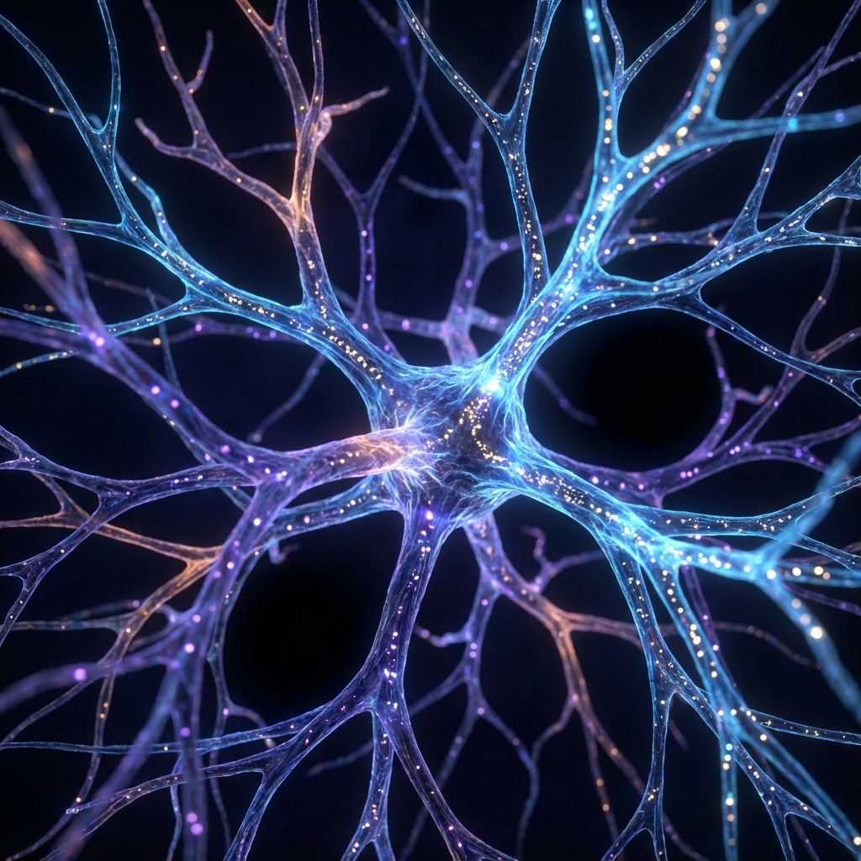
AI Systems Forget Everything
Current Solutions: ❌ Massive context windows (expensive, inefficient) ❌ RAG systems (lose context, brittle) ❌ Fine-tuning (requires model access, costly)
847 AI startups failed in 2024
Most built without validation
The Real Problem: AI doesn't know what to remember
and what to forget

Slide 3
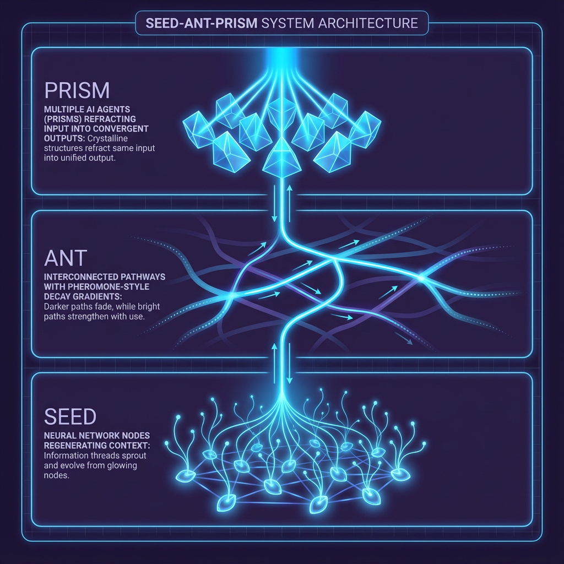
Pheromone-Inspired Memory Protocols
SEED — Context Regeneration Neural network nodes regenerating context.
Compresses patterns, not data.
ANT — Pheromone Decay Gradients Darker paths fade, brighter paths strengthen.
Usage-based memory navigation.
PRISM — Multi-Agent Validation Crystalline structures refract input.
Personalized output per observer.
Works at orchestration layer = anyone can use it

Slide 4

We Used Our Tool to Validate Our Tool
193 papers scanned 11 search queries 0 prior art matches 100% novelty score
"Pheromone-inspired LLM memory optimization" → Zero published research exists
We dogfooded our own protocols for validation.
That's the transparency we bring to everything.

Slide 5
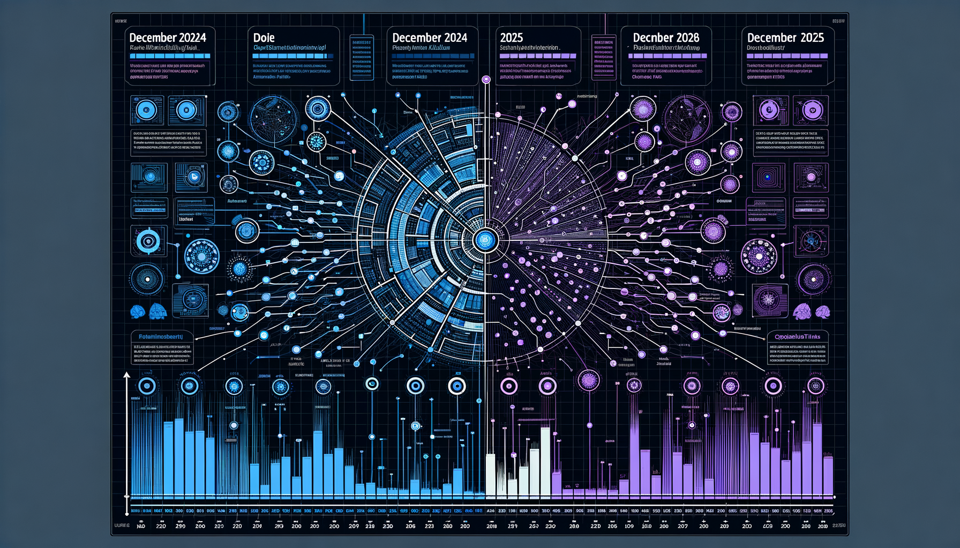
The Race to AI Memory Optimization
Dec 31, 2024 Google publishes Titans (theory paper) Dec 15, 2025 We ship SEED-ANT-PRISM (working protocols) Q1 2026 Memory optimization = hottest AI topic
Our Advantage: ✅ Practical implementation (not just theory) ✅ Orchestration layer (accessible to all) ✅ Validated novelty (not derivative)

Slide 6
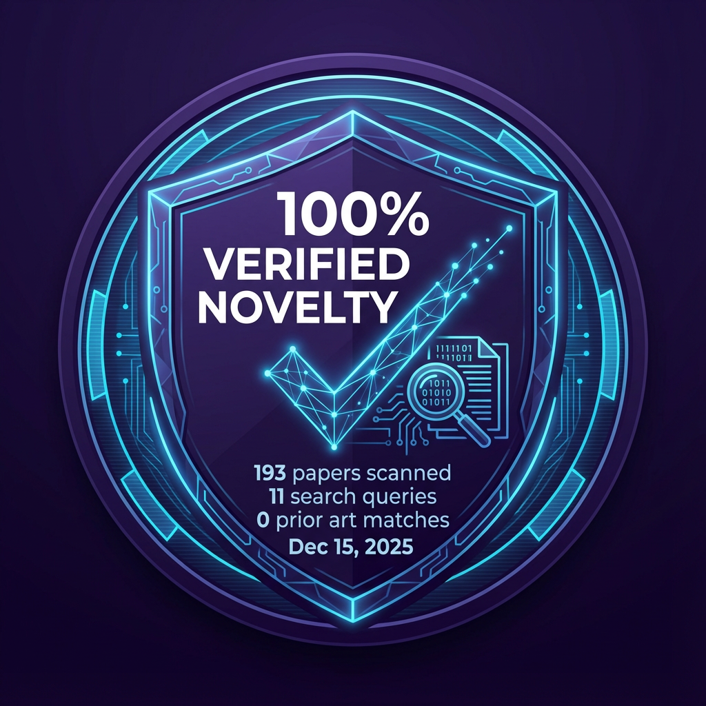
4 Weeks: Concept to Validated Research
What We Built: • 27.9GB naturalistic conversation dataset • H-010: Timeline prediction (100% accuracy) • KINGSLAYER: Market pattern detection • Prior art scan: 193 papers, 0 matches
Living Proof: Non-coder → Cutting-edge AI research → 4 weeks That's the democratization we're teaching.

Slide 7
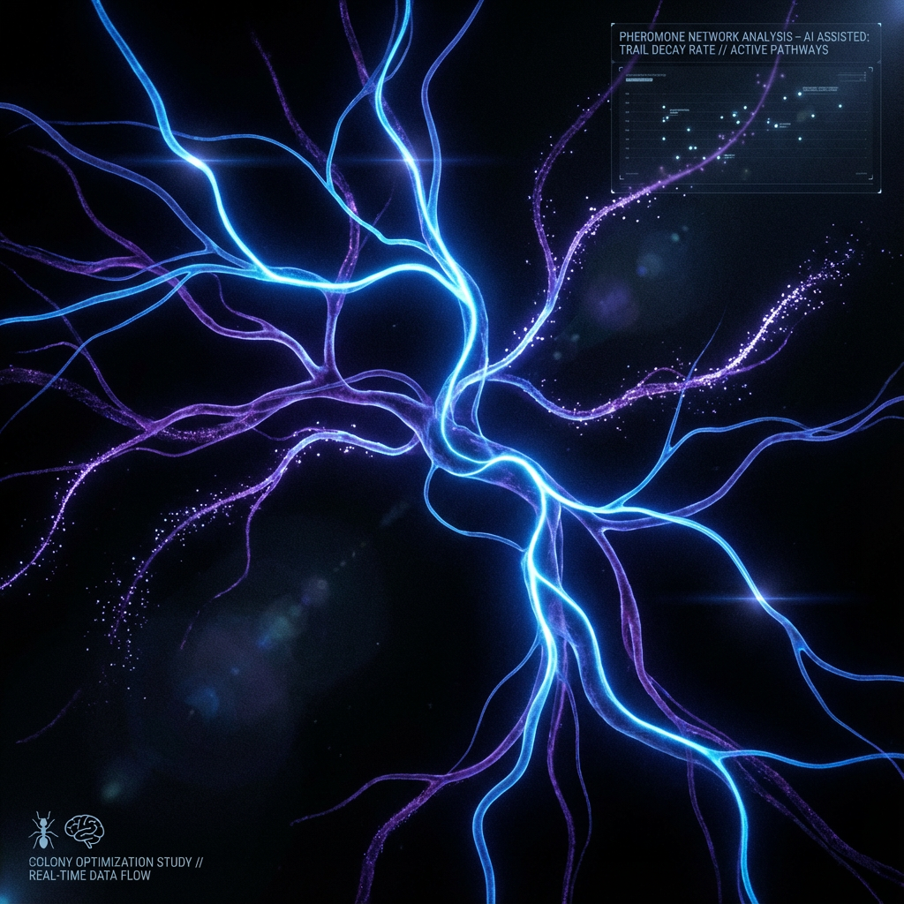
Partnership, Not Just Capital
MONTH 1-2: Publishing Guidance → First research paper + University connections MONTH 2-3: Enterprise Pilots → Portfolio company intros (5-10 pilots) MONTH 3-4: Talent Network → Research assistant via Lilypad MONTH 6-9: CMD School Beta → Launch to Founder Academy first
I've proven I can sprint alone.
Now I need partners who help me scale.

Slide 8

Joel Parkinson
Founder & AI Researcher | Adelaide, SA
Background: • Non-technical, learned AI orchestration in 4 weeks • ADHD brain = pattern recognition advantage • Solo sprint: Concept to validation (Nov 18 - Dec 15)
Unfair Advantage: Living proof democratization works. If I can do this, we can teach anyone.
Next Hires (with Blackbird's help): • Month 3: Research assistant (Lilypad) • Month 6: Technical co-founder

Slide 9
Three Monetization Paths
1. Research Consulting (Immediate) $10K-50K per engagement Target: 10-15 clients Month 1-3
2. CMD School (6 months) AI orchestration education at scale Free tier → Paid premium ($9-49/mo)
3. IP Licensing (12 months) SEED-ANT-PRISM to enterprises $500K+ ARR potential
All paths validate the thesis:
AI memory needs biological patterns,
and this knowledge should be democratized.

Slide 10
$500K Seed Investment
6-9 Month Sprint
Use of Funds: $200K Founder runway (9 months, lean) $100K Compute & infrastructure $100K Research publication (conferences) $50K First hire (research assistant) $50K CMD School foundation
Credit Unlock Scenario: Google AI: $350K (pending, VC helps) Anthropic: $100K+ (requires VC) OpenAI: $100K+ (requires VC) → If approved: $100K reallocates
to second hire or partnerships
Decision Timeline: Submit: Dec 18 → Meetings: Dec 23 → Close: Jan 31
AI moves in quarters, not years.

